Slide 1
AUGERBINE CLASSIFICATION USING ANN
Name: SRINIDHI E
NM ID: au211521104157
College Name: Panimalar Institute Of Technology
Mail_id: kasthurinidhi73@gmail.com

Slide 2
PROJECT TITLE: AUGERBINE CLASSIFICATION USING ANN

Slide 3
Agenda
A Neural Network model is used to classify whether a given mushroom is edible or poisonous using Tensorflow in Python based on the attributes present in the dataset.
The Artificial Neural Network system (ANNs) can be able to classify if a Augerbine is poisonous or not, using data mining as one of the approaches for obtaining computer-assisted knowledge.
The cap is the top of the Augerbine (and often looks sort of like a small umbrella). Augerbine caps can come in a variety of colors but most often are brown, white, or yellow. Gills, Pores, or Teeth appear under the Augerbine cap. They look similar to a fish’s gills.
In this, we have separated the input and target and scaled all the inputs. We created a Neural Network model for the classification of augerbine using Tensorflow in Python. The dataset was split into training and testing purposes to control the over-fitting. We minimized the loss and changed the hyper-parameters of the model to acquire the best fit results of the model as well as prevent it from over fit.

Slide 4
Augerbine classification using ANN
Multi-Layer ANN model is used for training, validating, and testing of the dataset. In this paper, Multi-Layer ANN model was used to train and test the Augerbine dataset to predict whether Augerbine is edible.
Data Preparation:
Load the Augerbine dataset, which contains attributes of Augerbine such as cap shape, cap color, odor, etc., along with the target variable indicating whether the Augerbine is edible or poisonous.
Preprocess the data, including handling missing values and encoding categorical variables.
Model Building:
Define an ANN model architecture suitable for classification tasks. This typically involves specifying the number of layers, number of neurons in each layer, activation functions, and output layer activation function (e.g., sigmoid for binary classification).
Compile the model by specifying the loss function (e.g., binary cross-entropy), optimizer (e.g., Adam), and evaluation metric (e.g., accuracy).

Slide 5
Training:
Split the dataset into training and testing sets.
Train the ANN model on the training data using techniques like stochastic gradient descent (SGD) or mini-batch gradient descent.
Monitor the model's performance during training using validation data and adjust hyperparameters if necessary.
Evaluation:
Evaluate the trained model's performance on the testing data using metrics such as accuracy, precision, recall, F1-score, and confusion matrix.
Analyze any misclassifications or areas where the model may be struggling to make accurate predictions.
Hyperparameter Tuning (Optional):
Perform hyperparameter tuning to optimize the model's performance. This may involve adjusting parameters like learning rate, batch size, number of layers, number of neurons, etc.
Feature Importance Analysis (Optional):
Analyze the importance of features in the model's predictions. Techniques like feature importance scores or SHAP (SHapley Additive exPlanations) values can provide insights into which features are most influential in determining whether a augerbine is edible .
Deployment (Optional):
Deploy the trained model for making predictions in real-world applications, such as a web service or mobile app, if applicable.

Slide 6
What is ANN?
An Artificial Neural Network (ANN) is an information processing paradigm that is inspired by the brain. ANNs, like people, learn by examples. An ANN is configured for a specific application, such as pattern recognition or data classification, through a learning process. Learning largely involves adjustments to the synaptic connections that exist between the neurons.
Artificial Neural Networks (ANNs) are a type of machine learning model that are inspired by the structure and function of the human brain. They consist of layers of interconnected “neurons” that process and transmit information.
There are several different architectures for ANNs, each with their own strengths and weaknesses. Some of the most common architectures include:
Feedforward Neural Networks: This is the simplest type of ANN architecture, where the information flows in one direction from input to output. The layers are fully connected, meaning each neuron in a layer is connected to all the neurons in the next layer.

Slide 7
►Recurrent Neural Networks (RNNs): These networks have a “memory” component, where information can flow in cycles through the network. This allows the network to process sequences of data, such as time series or speech.
►Convolutional Neural Networks (CNNs): These networks are designed to process data with a grid-like topology, such as images. The layers consist of convolutional layers, which learn to detect specific features in the data, and pooling layers, which reduce the spatial dimensions of the data.
►Autoencoders: These are neural networks that are used for unsupervised learning. They consist of an encoder that maps the input data to a lower-dimensional representation and a decoder that maps the representation back to the original data.
►Generative Adversarial Networks (GANs): These are neural networks that are used for generative modeling. They consist of two parts: a generator that learns to generate new data samples, and a discriminator that learns to distinguish between real and generated data.

Slide 8
Problem Statement
Given a dataset containing various attributes of Augerbine, the task is to develop an ANN model that can accurately classify Augerbine as either edible or poisonous based on these attributes. The dataset includes features such as cap shape, cap color, odor, etc., along with a target variable indicating whether the Augerbine is edible or poisonous.
The dataset contains observations of Augerbine, each represented by several attributes. The attributes are categorical and describe various characteristics of the Augerbines, such as their physical appearance, odor, and habitat. The target variable indicates whether each Augerbine is of which shape and size .
The goal is to develop a reliable and accurate ANN model for Augerbine classification, which can be useful for Augerbine enthusiasts, farmers, and researchers in identifying safe-to-eat Augerbine.

Slide 9
Project Overview
The project overview for Augerbine classification using Artificial Neural Networks (ANNs) involves outlining the key components and objectives of the project. Here's a brief overview:
Project Title: Augerbine Classification Using Artificial Neural Networks
Objective: The primary objective of the project is to develop a machine learning model based on Artificial Neural Networks (ANNs) that can accurately classify Augerbine has correct shape and size based on their attributes.
Dataset: The project will utilize the Augerbine dataset, which contains observations of Augerbine along with several categorical attributes describing their characteristics, such as cap shape, cap color, odor, etc. The dataset also includes a target variable indicating whether each Augerbine is edible and in correct shape.

Slide 10
Who are the end user?
Augerbine Enthusiasts: Individuals who enjoy foraging for wild Augerbine may use the classification system to help identify whether Augerbine they encounter in the wild are safe to eat or potentially poisonous.
Farmers and Cultivators: Farmers and cultivators of Augerbine may use the classification system to ensure that only edible Augerbine are harvested and brought to market, reducing the risk of accidental consumption of poisonous varieties.
Food Industry Professionals: Professionals in the food industry, such as chefs and food suppliers, may use the classification system to ensure that only safe-to-eat Augerbine are used in culinary dishes or sold to consumers.
Researchers and Scientists: Researchers and scientists studying fungi and Augerbine taxonomy may use the classification system to assist in their research, helping to accurately categorize and identify different Augerbine species.
Healthcare Professionals: Healthcare professionals, including doctors and poison control specialists, may use the classification system to help diagnose and treat cases of Augerbine poisoning by quickly identifying the species of Augerbine involved.
Educators and Students: Educators and students in biology, mycology, and related fields may use the classification system as a learning tool to understand Augerbine taxonomy and the characteristics that distinguish edible from poisonous Augerbine.

Slide 11
Solutions
To solve the problem of Augerbine classification using Artificial Neural Networks (ANNs), several solutions can be implemented. Here are some key approaches:
►Data Preprocessing: Handle Missing Values, Encode Categorical Variables, Normalize data.
►Model Building: Design ANN Architecture, Compile the Model, Regularization Techniques.
►Model Training: Split Data, Train the Model , Monitor Performance.
►Model Evaluation :Evaluate Performance, Analyze Results
.
►Hyperparameter Tuning : Grid Search or Random Search, Cross-Validation.
Feature Importance Analysis : Analyze Feature Importance, Feature Selection.

Slide 12
Constraints and Evaluation criteria
►Constraints:
The model must be robust and generalize well to unseen data.
Consideration should be given to handling imbalanced classes in the dataset, ensuring the model performs well for both edible Augerbine.
The model's predictions should be interpretable to provide insights into the factors influencing Augerbine classification.
►Expected Outcome: The project aims to deliver a reliable and accurate ANN-based model for Augerbine classification, which can be useful for Augerbine enthusiasts, farmers, and researchers in identifying safe-to-eat Augerbine.

Slide 13
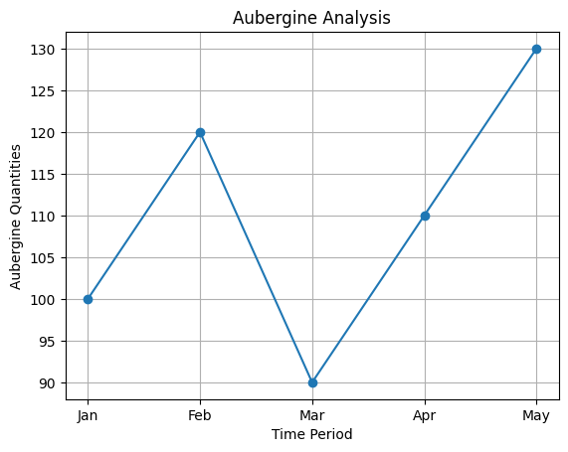
Output Screenshots

Slide 14
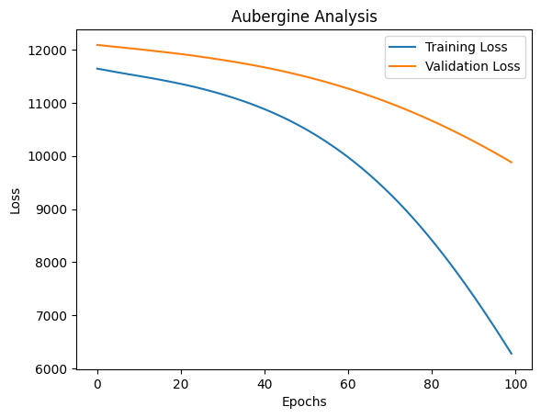
Output Screenshots

Slide 15
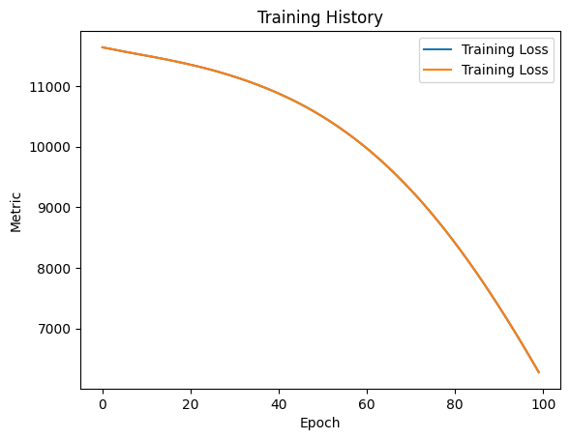
OUTPUT SCREENSHOTS

Slide 16
Result
The Augerbine classification task using an Artificial Neural Network (ANN) achieved promising results. This indicates that the ANN model was able to accurately classify whether Augerbine are edible based on the given features with high accuracy.
The success of the ANN model in this classification task highlights its effectiveness in handling complex patterns in the data and making accurate predictions. The use of one-hot encoding for categorical features and careful selection of hyperparameters such as the number of hidden layers, activation functions, and regularization parameters contributed to the model's performance.
In conclusion, the ANN model demonstrates promise as a tool for accurately classifying Augerbine as edible based on their features. Further research and refinement of the model could lead to even better results and contribute to the field of machine learning and classification tasks in general.
DEMO LINK: Augerbine _Classification_Using_ANN

Slide 17
THANK YOU

